Slide 1
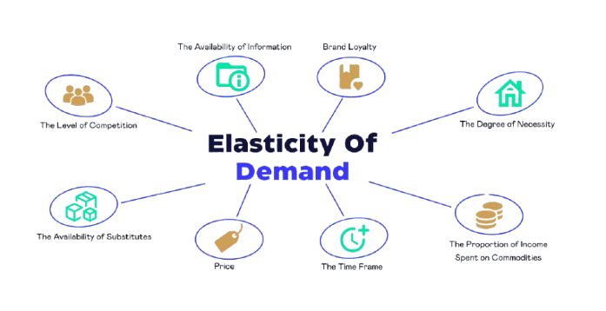
Price Elasticity Modelling using Pyspark
Final project group 1-3
Himanshu hegde
Nawazish khalandar
Pranav MAHESH mekal
Keerthi Krishna aiyappan

Slide 2

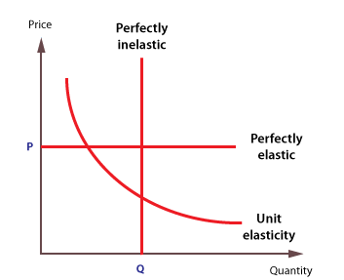



Project Overview - I
The demand for a product in the market is defined by:
Price
Alternate Options
Demo-graphics
Preferences
Economy
Marketing
Seasonality
Price Elasticity measures how sensitive consumer demand is to changes in price
Elasticity IE > 1: Demand is Elastic; Consumers responsive to price changes.
Elasticity IE < 1: Demand is Inelastic; Changes in price have a smaller effect on the quantity demanded.
Elasticity IE = 1: Change in demand proportional to change in price.
Why Price Elasticity Modelling:
To MAXIMIZE PROFITS

Slide 3







Project Overview - II
STAKEHOLDERS
Quantify diminishing returns of increasing a product’s price and identify optimal returns from such adjustments
Retailers
Businesses
Marketing
And Sales Teams
Service Providers
Leveraging Price Elasticity of Demand (PED) to quantify how sensitive consumers are to price changes. We break down demand into elastic, inelastic, and unitary categories to offer a method to identify products volatile to price changes
ABOUT THE DATA
Source: Snowflake's sample data on sales and pricing
Features: Mix of categorical (product, manufacturer, brand, product type), and numerical (price, quantity, discount, total price) attributes, along with an order date and a unique identifier.
Most PED models rely on multi-linear regression, we use non-linear methods to capture the complex relationship between price and demand.

Slide 4
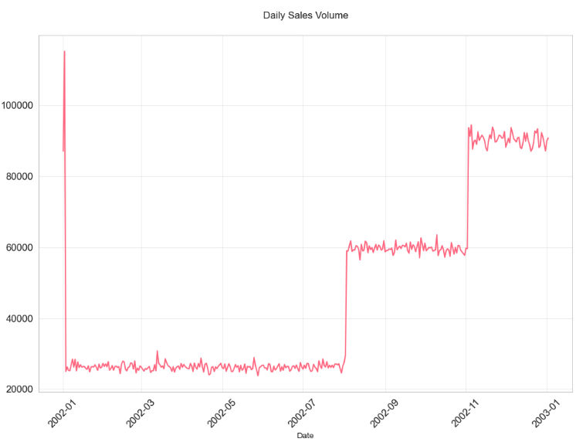
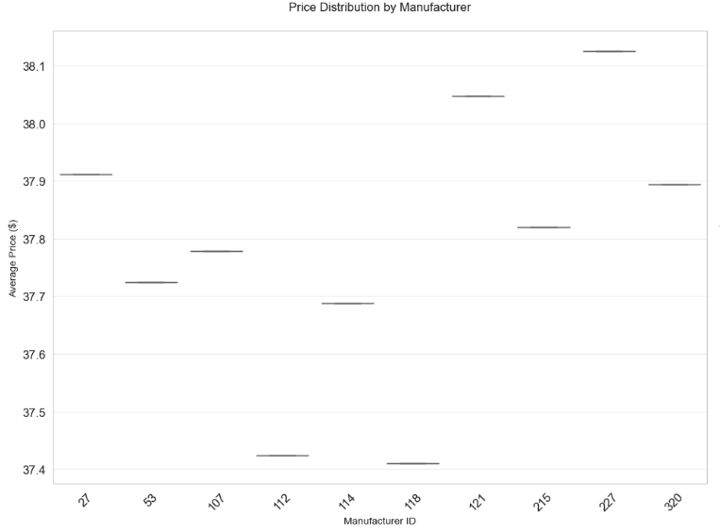
EDA - I
Overall Sales Volume over time(Daily)
Average price($) distribution by Manufacturer
Overall sales volume drops drastically in the beginning but starts improving in the latter half of the year with spikes seen around the holiday season
We narrowed down manufacturer 320 as our manufacturer due to the abundance of competitive manufacturers in price ranges above and below ours.

Slide 5
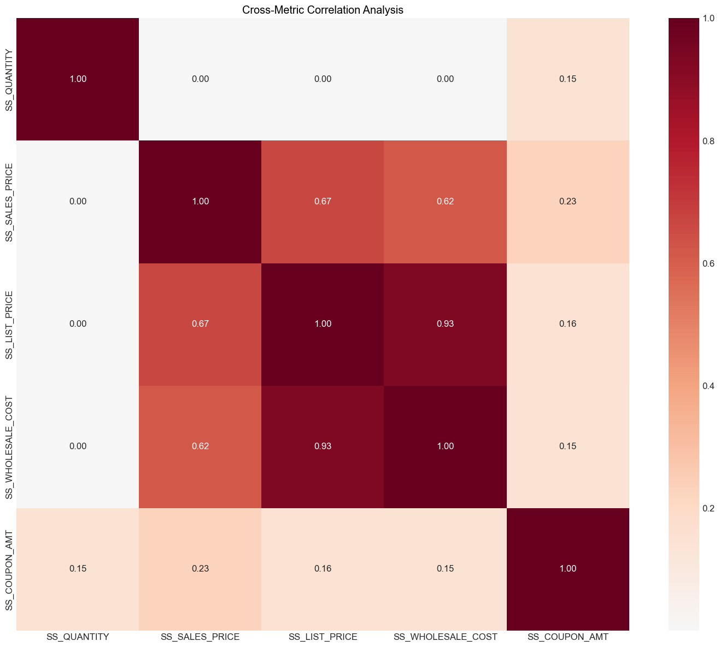
EDA - II
Coupon Amount has the highest correlation with quantity among the baseline price metrics. This makes sense as people are more likely buy when there is a discount or a promotion running.

Slide 6
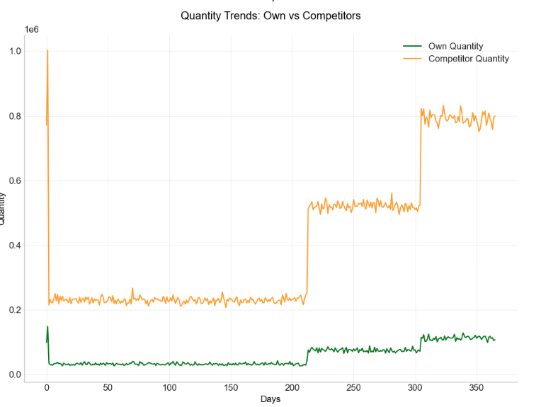
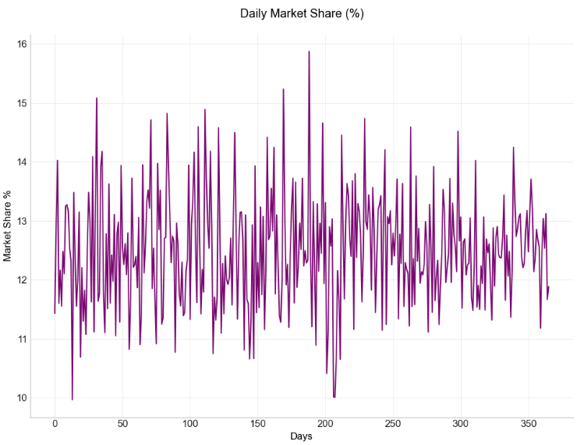
EDA - III
The macro trends remain consistent for our manufacturers (320) and our competitors throughout the time period.
The micro trends vary slightly due to the possibility of marketing campaigns, celebrity endorsements etc.
Daily Market Share (12%-14%) for Manufacturer 320 indicates the demand for the products sold by our manufacturer

Slide 7

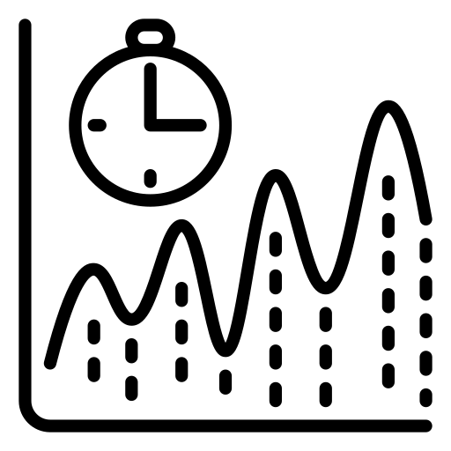

Feature Engineering - I
Competitor Features
Temporal Features
Promotions and Discounts
Premium Distance: Product price distance from premium product
Competitors in band: Number of competitors in a similar price band.
Price share above: Share of products with product price below our product
Price dispersion: Variance of product price for each competitor.
Price Change: Change in product price over a time period.
Price 30-day average: Moving average of product price over a 30 day period.
Price 60-Day average: Moving average of product price over a 60 day period.
Price 90-day average: Moving average of product price over a 90 day period.
Relative discount: This is relative discount offered over other manufacturers and categories
Promotion Frequency: Total promotions given per time period.
Discount Depth: Percentage discount given per product

Slide 8


Feature Engineering - II
Location based Features
Category Features
Store Density: Count of stores in the region.
Region Income: Average income in the region.
Regional competition: Count of competitors in the region.
Relative price index: Index indicating relative product price with respect to other products in the same category.
Price percentile: Percentile rank of product price across the category.

Slide 9



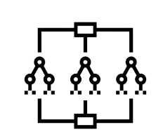





Modelling
Data Splitting method: Temporal train test split
Model
Model
Model
Random Forest:
Gradient Boosting:
Decision Trees:

Slide 10


Optimization
Optimization Results
What are we optimizing?
Product Price
Why are we optimizing?
Maximize Profits (Quantity Sold)
We originally sold 168,052 units.
On optimizing product price within given constraints, we see an increase of 4.3% in product quantity sales.
Set our initial constraint (+/-15% of product cost on a given day)
Scipy L-BFGS-B Optimizer
Loss Function – Total Quantity Sold
Optimization:
How are we optimizing?
Optimizer accounts for our constraints
Plugs in the new product price
Predicts total quantity sold from the model
Repeats until max sales quantity is achieved

Slide 11
Challenges
Blackbox model interpretability: Unavailability of model interpretation libraries, like Shapley, to examine and explain what has been learnt from the models. Plotting line graphs and partial dependence plots using PySpark can be challenging.
Lack of Optimizers in PySpark: Only simple optimizers like SGD, which are inapplicable for linear programming, are accessible in PySpark.
Data size issues: Worked with a subset of data because large datasets could not be processed by PySpark on the available infrastructure.
Lack of interpretable consumer demographic information: Some aspects of customer data like buying potential and income bands do not have an interpretable relationship with quantity.
Next Steps
Optimization from a business perspective: Tracking revenue from our optimization model to meet stakeholder needs constitutes our next steps.
Summary
Our primary goal was to optimize quantity sold, and in turn revenue. While we have optimized quantity sold, we are finalizing the optimization for revenue part.

